Slide 1
Business Analytics
Dr. Mehmet Yasin Ulukuş
Lecture 2
Graphical Solution Technique – Sensitivity Analysis – Excel Solver

Slide 2
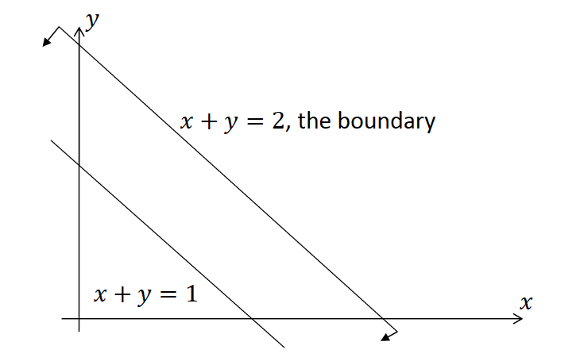
Analytical Geometry Revisited
What does an inequality mean?
For example: 𝑥+𝑦≤2
A half space!

Slide 3
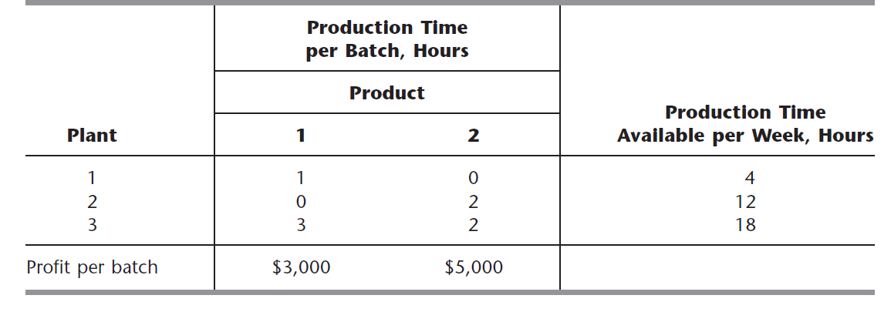
Wyndor Glass Co Example
The WYNDOR GLASS CO. produces two types of glasses. Product 1 requires some of the production capacity in Plants 1 and 3, but none in Plant 2. Product 2 needs only Plants 2 and 3. The marketing division has concluded that the company could sell as much of either product as could be produced by these plants. However, because both products would be competing for the same production capacity in Plant 3, it is not clear which mix of the two products would be most profitable. Therefore, an OR team has been formed to study this question and came up with the following information.

Slide 4
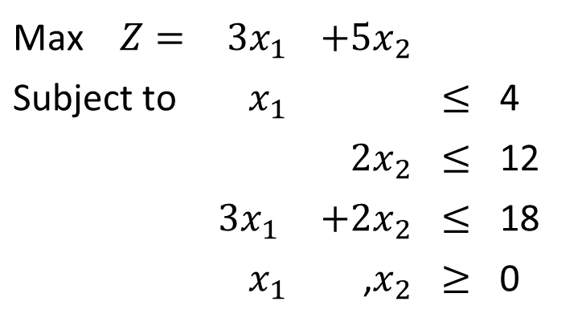
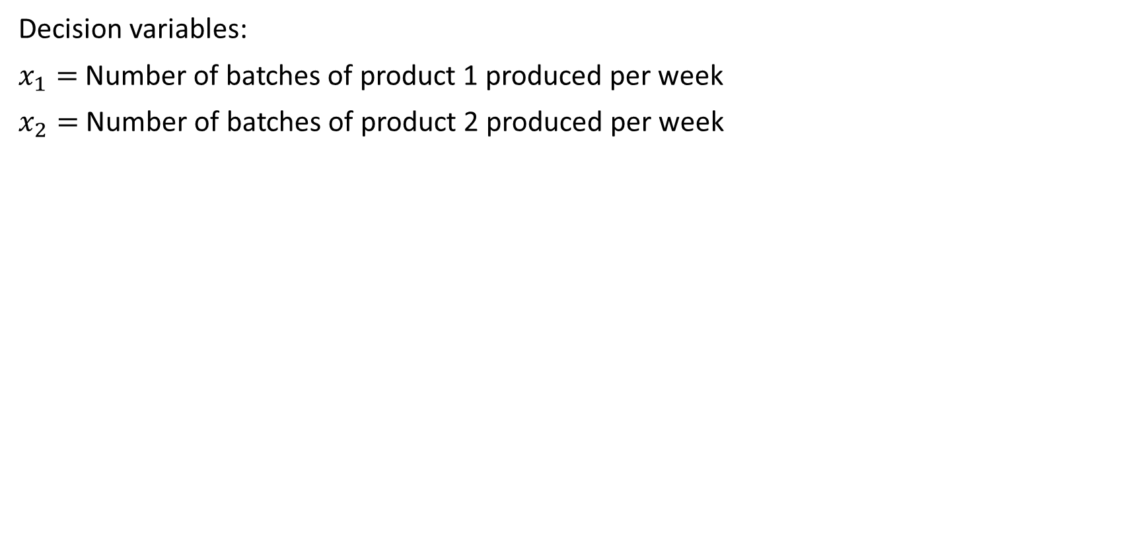
Wyndor Glass Co LP Problem
Decision variables:
$x_{1}=$ Number of batches of product 1 produced per week
$x_{2}=$ Number of batches of product 2 produced per week
Max $Z=$ | $$3x_{1}$$ | $$+5x_{2}$$
Subject to | $$x_{1}$$ |  | $$≤$$ | 4
 |  | $$2x_{2}$$ | $$≤$$ | 12
 | $$3x_{1}$$ | $$+2x_{2}$$ | $$≤$$ | 18
 | $$x_{1}$$ | ,$x_{2}$ | $$≥$$ | 0

Slide 5
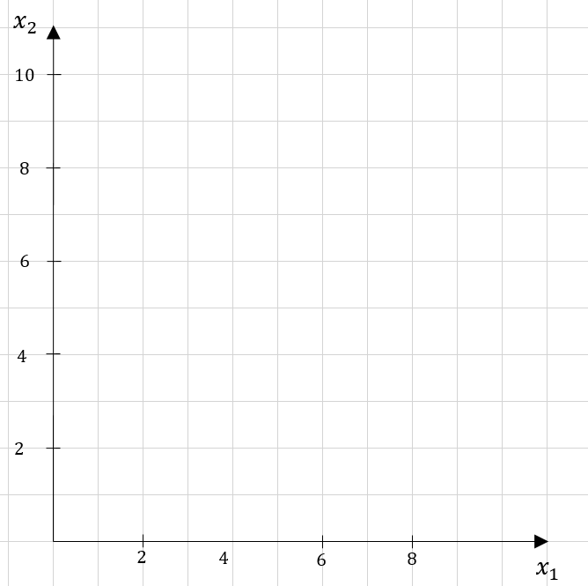
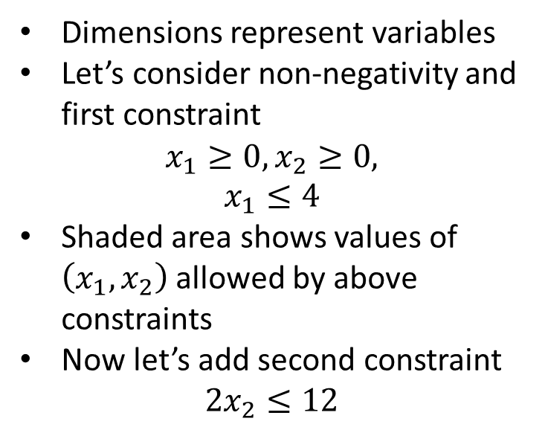

Feasible Region
$$x_{1}=4$$
Dimensions represent variables
Let’s consider non-negativity and first constraint
$$x_{1}≥0, x_{2}≥0,$$
$$x_{1}≤4$$
Shaded area shows values of $\left(x_{1},x_{2}\right)$ allowed by above constraints
Now let’s add second constraint
$$2x_{2}≤12$$

Slide 6
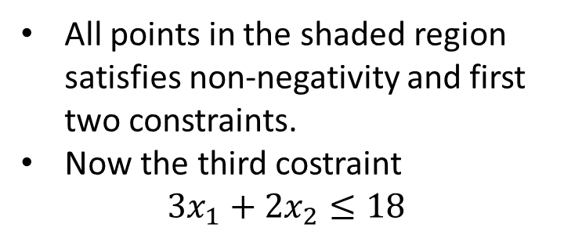

Feasible Region
$$x_{1}=4$$
All points in the shaded region satisfies non-negativity and first two constraints.
Now the third costraint
$$3x_{1}+2x_{2}≤18$$
$$2x_{2}=12$$

Slide 7

Feasible Region
$$x_{1}=4$$
Feasible Region: The set of all points satisfying all constraints (shaded area)
All points falling within the feasible region is a feasible solution (infinitely many solutions)
But we need to find the best one!
How?
$$2x_{2}=12$$
$$3x_{1}+2x_{2}=18$$

Slide 8




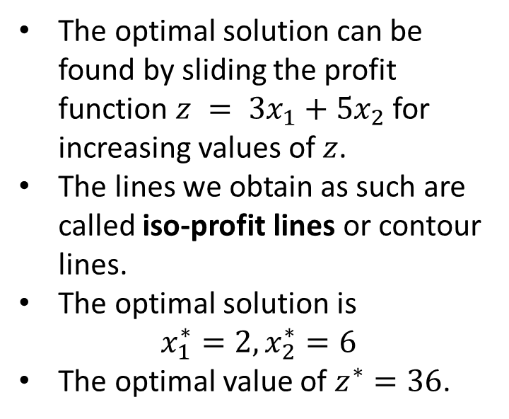
Finding Optimal Solution
$$x_{1}=4$$
The optimal solution can be found by sliding the profit function $z = 3x_{1}+5x_{2}$ for increasing values of $z$.
The lines we obtain as such are called iso-profit lines or contour lines.
The optimal solution is
$$x_{1}^{∗}=2, x_{2}^{∗}=6$$
The optimal value of $z^{∗}=36$.
$$36=3x1+5x2$$
$$2x_{2}=12$$
$$20=3x1+5x2$$
$$15=3x1+5x2$$
$$10=3x1+5x2$$
$$3x_{1}+2x_{2}=18$$

Slide 9
Extreme Points – Binding Constraints
$$x_{1}=4$$
Extreme Points: Corner points that are the intersection of boundary lines
LP problem has finite number of extreme points
There exists an optimal solution at an extreme point
Feasible Region is a convex set
$$2x_{2}=12$$
$$3x_{1}+2x_{2}=18$$

Slide 10
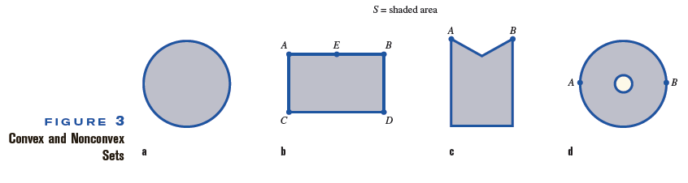
Terminology
DEFINITION 4: CONVEX AND NON-CONVEX (CONCAVE) SETS
Set of points S is called a convex set if the line segment joining any pair of points in S is wholly contained in S.

Slide 11
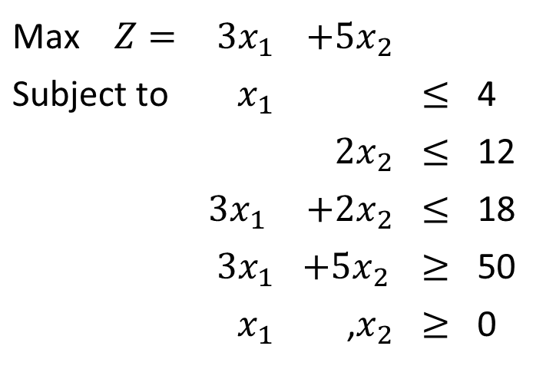
Infeasible Solution
Add a new constraint saying the new products requires to provide at least $50,000 profit
The new model is
Max $Z=$ | $$3x_{1}$$ | $$+5x_{2}$$
Subject to | $$x_{1}$$ |  | $$≤$$ | 4
 |  | $$2x_{2}$$ | $$≤$$ | 12
 | $$3x_{1}$$ | $$+2x_{2}$$ | $$≤$$ | 18
 | $$3x_{1}$$ | $$+5x_{2}$$ | $$≥$$ | 50
 | $$x_{1}$$ | ,$x_{2}$ | $$≥$$ | 0

Slide 12

Infeasible Solution
$$x_{1}=4$$
The constraints are conflicting with each other.
There is no intersection between the regions.
No feasible solution, hence the problem is infeasible.
Note that optimal solution is always one of the feasible solutions, thus no optimal solution here as well.
$$2x_{2}=12$$
$$3x_{1}+5x_{2}=50$$
$$3x_{1}+2x_{2}=18$$

Slide 13
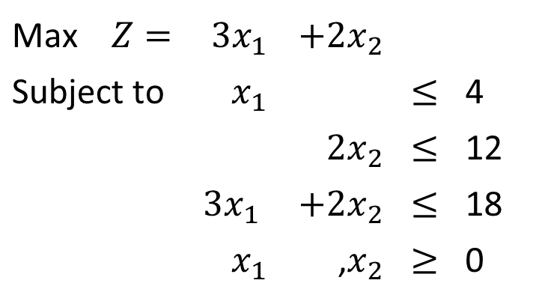
Multiple Optimal Solutions
What if we earn a profit of 2K instead of 5K from product two?
The new model is
Max $Z=$ | $$3x_{1}$$ | $$+2x_{2}$$
Subject to | $$x_{1}$$ |  | $$≤$$ | 4
 |  | $$2x_{2}$$ | $$≤$$ | 12
 | $$3x_{1}$$ | $$+2x_{2}$$ | $$≤$$ | 18
 | $$x_{1}$$ | ,$x_{2}$ | $$≥$$ | 0

Slide 14


Multiple Optimal Solutions
$$x_{1}=4$$
Note that the iso-profit lines leave the feasible region not from a single point but a line segment.
All points along the line segment is optimal.
We have infinitely many optimal solutions, all have an optimal value of 18
Two extreme points (2,6) and (4,3) are among infinitely many optimal solutions.
$$18=3x1+2x2$$
$$2x_{2}=12$$
$$6=3x1+2x2$$
$$3x_{1}+2x_{2}=18$$

Slide 15
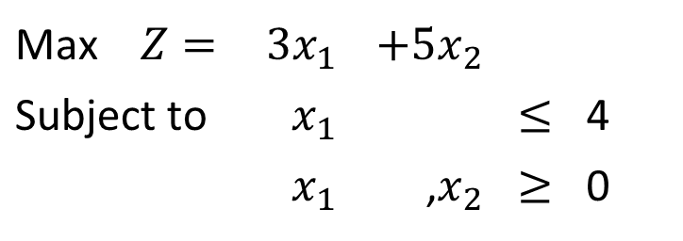
Multiple Optimal Solutions
What if we didn’t have the second and third constraints?
The new model is
Max $Z=$ | $$3x_{1}$$ | $$+5x_{2}$$
Subject to | $$x_{1}$$ |  | $$≤$$ | 4
 | $$x_{1}$$ | ,$x_{2}$ | $$≥$$ | 0

Slide 16
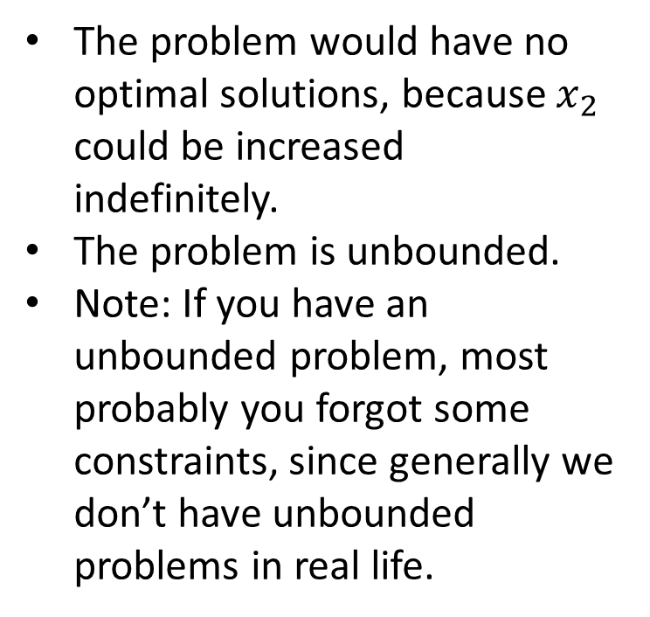
Unbounded Solutions
$$x_{1}=4$$
The problem would have no optimal solutions, because $x_{2}$ could be increased indefinitely.
The problem is unbounded.
Note: If you have an unbounded problem, most probably you forgot some constraints, since generally we don’t have unbounded problems in real life.

Slide 17
Insights Gained - Graphical Method
Unfortunately graphical methods cannot be extended handle problems with more than three variables (each dimension for one variable)
Understanding graphical method provides critical insights
Feasible region have a particular geometry, always a convex polytope (no matter the size and problem parameters).
The optimal solutions are always at the corner points, or extreme points.
Simplex algorithm exploits this property and moves around the extreme points to find the optimal solution
If multiple optimal solutions exist, then it has at least two extreme point optimal solutions
Slope of the objective function determines the optimal solution

Slide 18
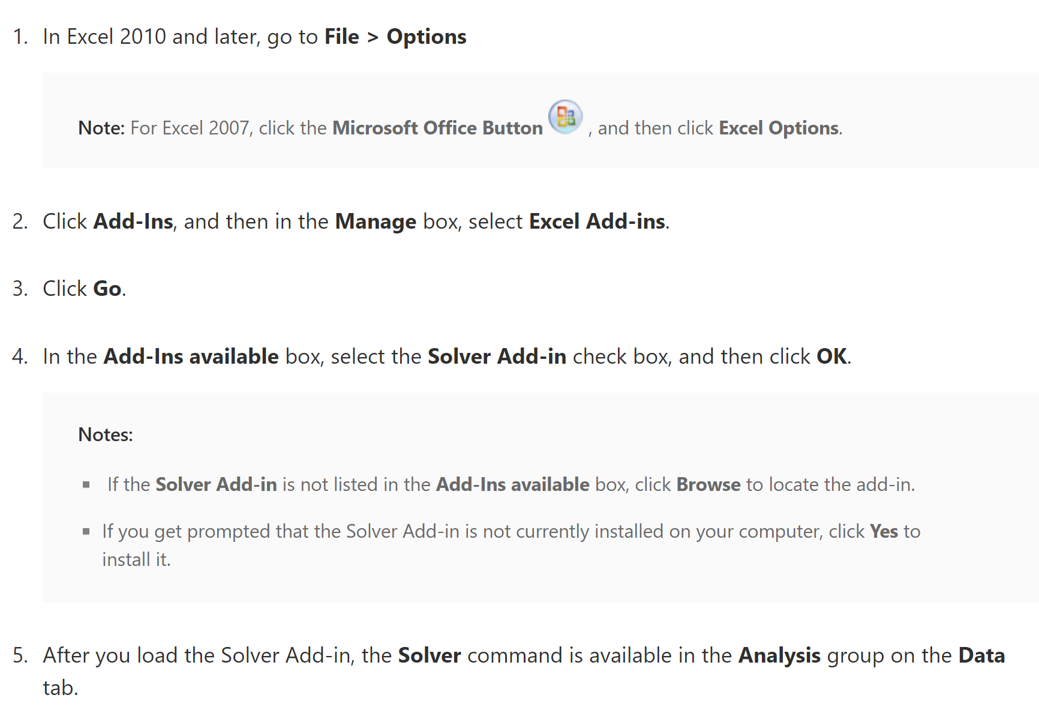
EXCEL SOLVER

Slide 19
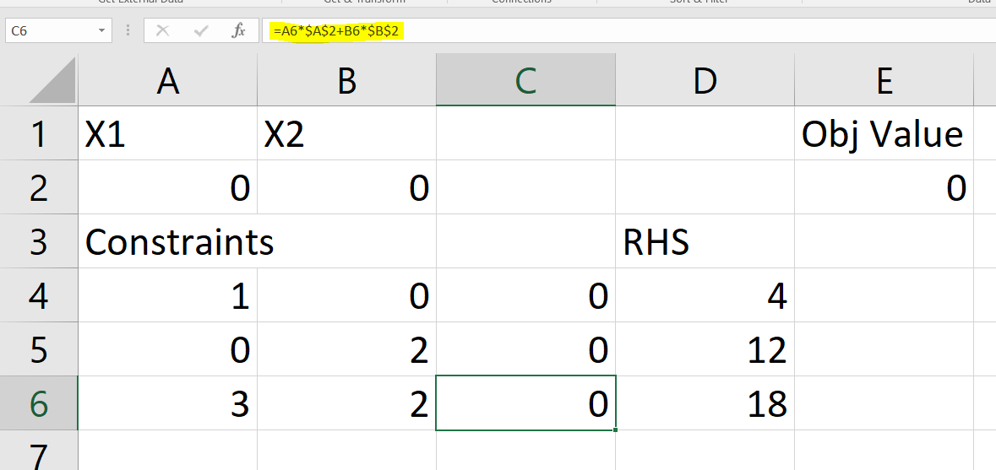
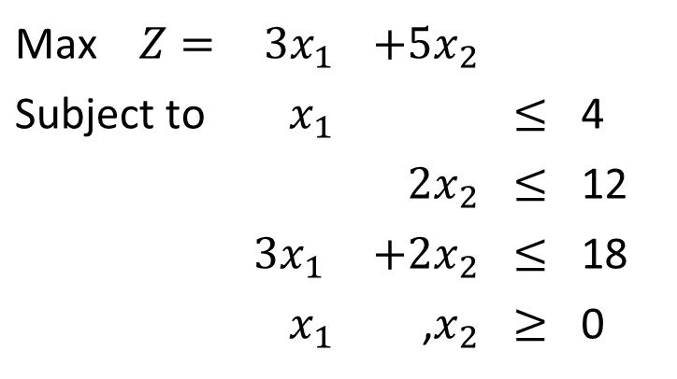
Example – Wyndco – EXCEL SOLVER
Write the constraints and objective functions using formulas as shown below
Initial values for decision variables can be set to 0
Max $Z=$ | $$3x_{1}$$ | $$+5x_{2}$$
Subject to | $$x_{1}$$ |  | $$≤$$ | 4
 |  | $$2x_{2}$$ | $$≤$$ | 12
 | $$3x_{1}$$ | $$+2x_{2}$$ | $$≤$$ | 18
 | $$x_{1}$$ | ,$x_{2}$ | $$≥$$ | 0

Slide 20
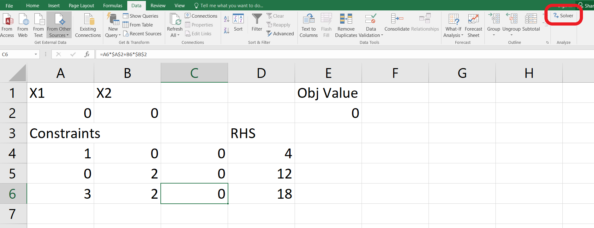
Example – Wyndco – EXCEL SOLVER
Go to Data Tab and Open Solver

Slide 21
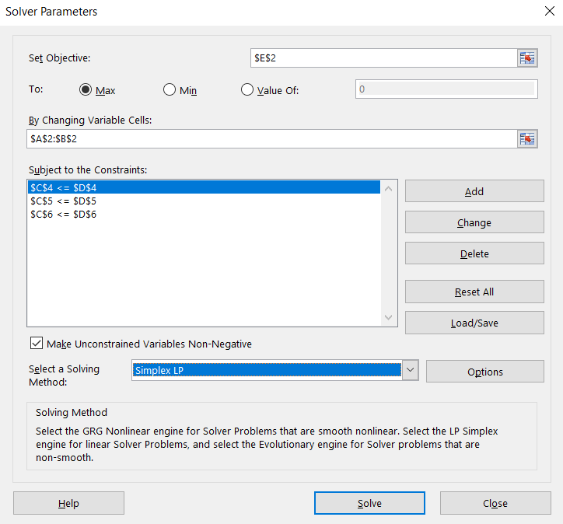
Example – Wyndco – EXCEL SOLVER
Set Objective = Objective function cell.
Set to Maximization or minimization depending on the problem.
By changing variable cells will be your decision variables.
Solving methods should be Simplex LP.
To add constraints click add

Slide 22
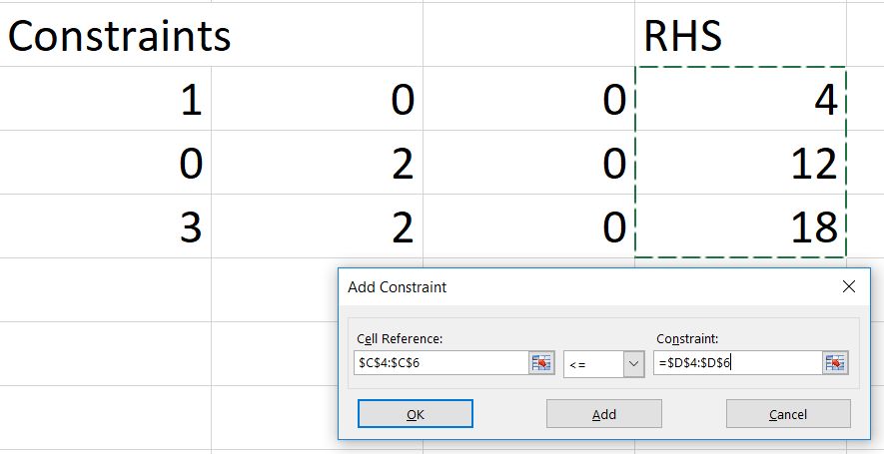
Example – Wyndco – EXCEL SOLVER
Choose cells.
Cells on the left will be the ones with formulas.
You can also add constraints one by one.

Slide 23
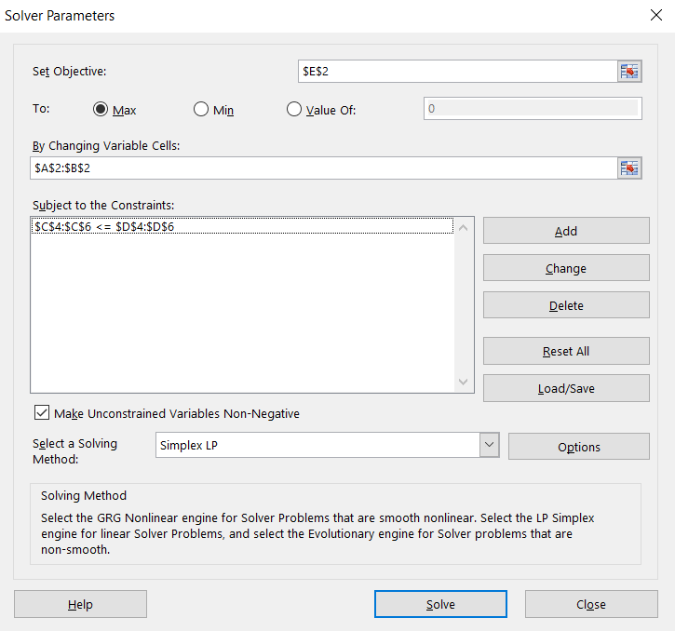
Example – Wyndco – EXCEL SOLVER
Click Solve

Slide 24
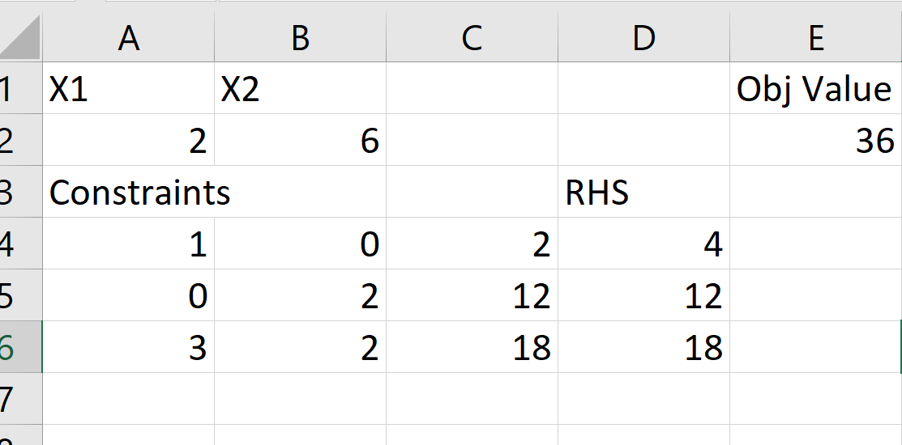
Example – Wyndco – EXCEL SOLVER
Solver found an optimal solution

Slide 25
SENSITIVITY ANALYSIS
An LP model should be considered as a snapshot of a real situation in which the model parameters assume static values.
It would be desirable to study the effect of changing the values of the model parameters.
This is called the sensitivity analysis.
It will provide answers to some questions frequently asked by the managers such as:
  What is the highest amount of money I will be willing to pay for an extra hour of labor?
  How will the change in the selling price of a product effect the total revenues?
  Would it be profitable if we had higher amount of the raw material to manufacture more products?

Slide 26
EXAMPLE - Giapetto Toys
Giapetto Woodcarving, Inc., manufactures two types of wooden toys: soldiers and trains. A soldier sells for $27 and uses $10 worth of raw materials. Each soldier that is manufactured increases Giapetto’s variable labor and overhead costs by $14. A train sells for $21 and uses $9 worth of raw materials. Each train built increases Giapetto’s variable labor and overhead costs by $10. Manufacturing soldiers and trains requires two types of skilled labor: carpentry and finishing. A soldier requires 2 hours of finishing labor and 1 hour of carpentry labor. A train requires 1 hour of finishing and 1 hour of carpentry labor. Each week, Giapetto can obtain all the needed raw material but only 100 finishing hours and 80 carpentry hours Demand for trains is unlimited, but at most 40 soldiers can be sold each week. Giapetto wants to maximize weekly profit (=revenues − costs).

Slide 27
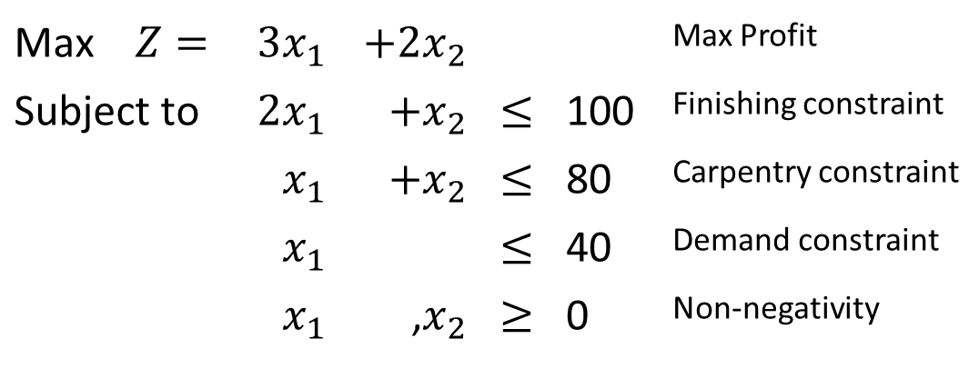
Giapetto Toys-LP FORM
Max $Z=$ | $$3x_{1}$$ | $$+2x_{2}$$ |  |  | Max Profit
Subject to | $$2x_{1}$$ | $$+x_{2}$$ | $$≤$$ | 100 | Finishing constraint
 | $$x_{1}$$ | $$+x_{2}$$ | $$≤$$ | 80 | Carpentry constraint
 | $$x_{1}$$ |  | $$≤$$ | 40 | Demand constraint
 | $$x_{1}$$ | ,$x_{2}$ | $$≥$$ | 0 | Non-negativity

Slide 28
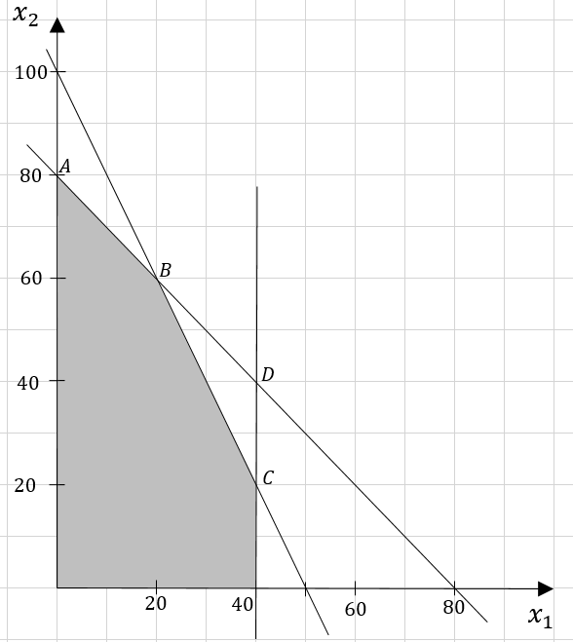
GRAPHICAL APPROACH
B= (20,60) is the current optimal solution with an optimal value of 180
Note that the slope of the objective function line is -3/2

Slide 29
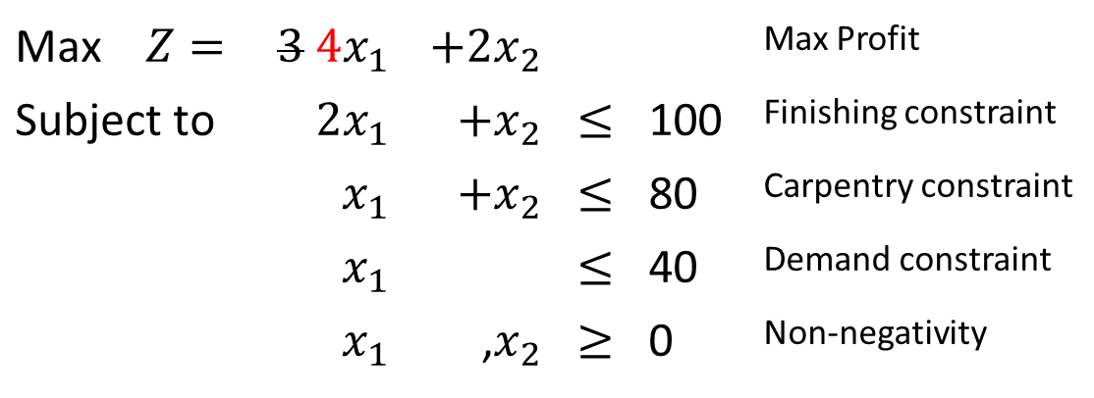
CHANGES IN THE OBJECTIVE FUNCTION COEFFICIENTS
If the profit of a manufactured soldier increases, then we would expect the optimal solution to require production of more soldiers
What happens if price of a soldier is 4 instead of 3? Should we produce more soldiers?
Max $Z=$ | $$3 4x_{1}$$ | $$+2x_{2}$$ |  |  | Max Profit
Subject to | $$2x_{1}$$ | $$+x_{2}$$ | $$≤$$ | 100 | Finishing constraint
 | $$x_{1}$$ | $$+x_{2}$$ | $$≤$$ | 80 | Carpentry constraint
 | $$x_{1}$$ |  | $$≤$$ | 40 | Demand constraint
 | $$x_{1}$$ | ,$x_{2}$ | $$≥$$ | 0 | Non-negativity

Slide 30

CHANGES IN THE OBJECTIVE FUNCTION COEFFICIENTS
If the profit of a manufactured soldier increases, then we would expect the optimal solution to require production of more soldiers
What happens if price of a soldier is 2 instead of 3? Should we produce less soldiers?
How do we find the range of values for the profit of a soldier in which the current solution remains optimal?
Max $Z=$ | $$3 2x_{1}$$ | $$+2x_{2}$$ |  |  | Max Profit
Subject to | $$2x_{1}$$ | $$+x_{2}$$ | $$≤$$ | 100 | Finishing constraint
 | $$x_{1}$$ | $$+x_{2}$$ | $$≤$$ | 80 | Carpentry constraint
 | $$x_{1}$$ |  | $$≤$$ | 40 | Demand constraint
 | $$x_{1}$$ | ,$x_{2}$ | $$≥$$ | 0 | Non-negativity

Slide 31
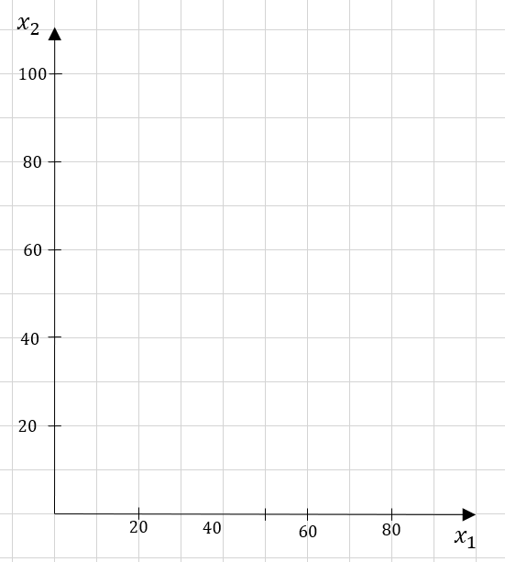
GRAPHICAL APPROACH
Let’s say the slope changed a bit
Still the same solution is optimal
A
A
B
B
D
C
C

Slide 32
GRAPHICAL APPROACH
What if the slope is exatly same as the carpentry constraint’s slope (-1)
Both point A and point B are optimal
Still point B is an optimal solution
A
B
D
C

Slide 33
Let’s look at the graph again
If the current value of the objective function slope (−3/2) becomes flatter than the carpentry constraint (whose slope is −1) then the optimal solution will move to the point A from point B
A
B
D
C

Slide 34
Let’s look at the graph again
What if the slope is exatly same as the finishing constraint’s slope (-2)?
Both point B and point C are optimal
Still point B is an optimal solution
A
B
D
C

Slide 35
Let’s look at the graph again
If the current value of the objective function slope (−3/2) becomes steeper than the finishing constraint (whose slope is −2) then the optimal solution will move to the point C.
A
B
D
C

Slide 36
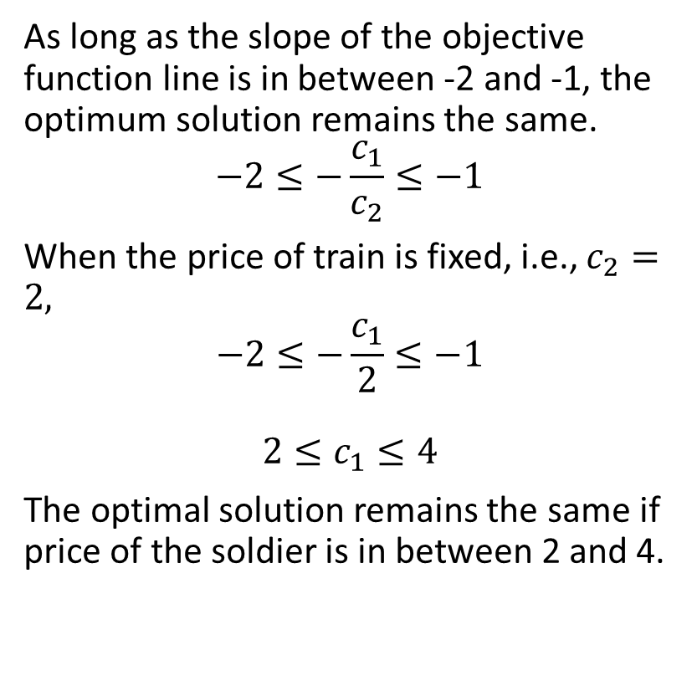
Interval for the price of soldier is found
As long as the slope of the objective function line is in between -2 and -1, the optimum solution remains the same.
$$−2≤−\frac{c_{1}}{c_{2}}≤−1$$
When the price of train is fixed, i.e., $c_{2}=2,$
$$−2≤−\frac{c_{1}}{2}≤−1$$
$$2≤c_{1}≤4$$
The optimal solution remains the same if price of the soldier is in between 2 and 4.
Slope= -2
A
B
D
Slope= -1
C

Slide 37
Changes in the RHS of the Constraints
What happens if the right hand side of the finishing hour constraint changes and becomes 110?
A
B
D
C

Slide 38
Changes in the RHS of the Constraints
What happens if the right hand side of the finishing hour constraint changes and becomes 110?
A
B
D
C

Slide 39
Changes in the RHS of the Constraints
What happens if the right hand side of the finishing hour constraint changes and becomes 110?
The optimum solution changed (from B to B’).
New solution is (30,50) with an optimum value of 190
The optimal value increased by 10 when we increase right hand side of the finishing constraint.
A
B
B’
D
C

Slide 40
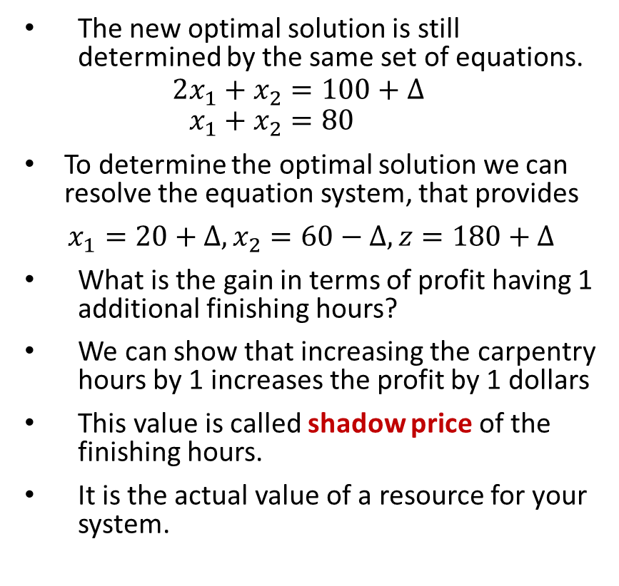
Changes in the RHS of the Constraints
The new optimal solution is still determined by the same set of equations.
$$2x_{1}+x_{2}=100+Δ \\ x_{1}+x_{2}=80$$
To determine the optimal solution we can resolve the equation system, that provides
$x_{1}=20+Δ, x_{2}=60−Δ, z=180+Δ$
What is the gain in terms of profit having 1 additional finishing hours?
We can show that increasing the carpentry hours by 1 increases the profit by 1 dollars
This value is called shadow price of the finishing hours.
It is the actual value of a resource for your system.
A
B
B’’
D
C

Slide 41
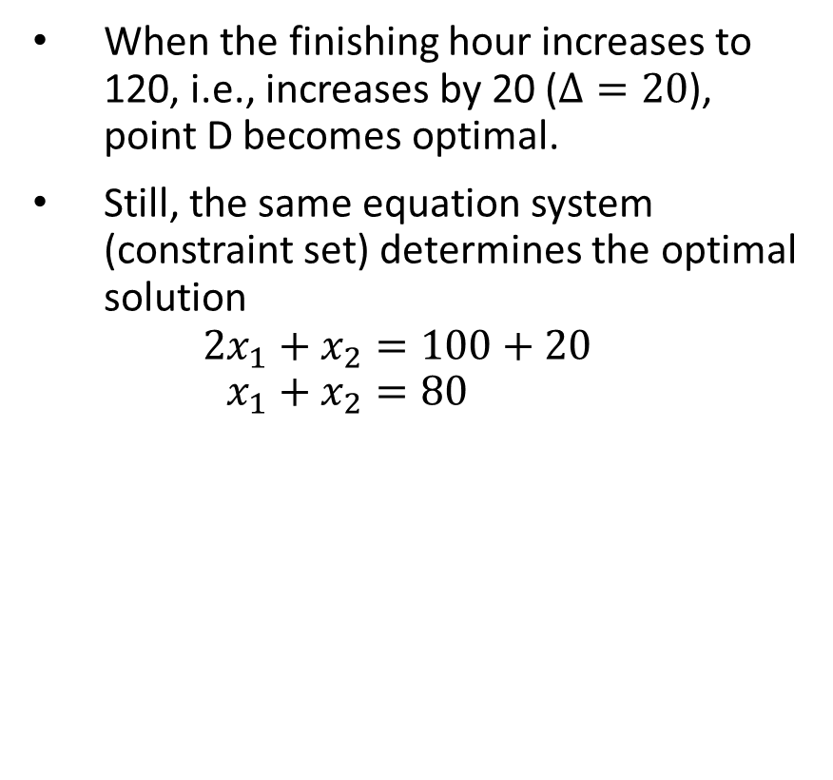
Changes in the RHS of the Constraints
When the finishing hour increases to 120, i.e., increases by 20 ($Δ=20$), point D becomes optimal.
Still, the same equation system (constraint set) determines the optimal solution
$$2x_{1}+x_{2}=100+20 \\ x_{1}+x_{2}=80$$
A
B
D
C

Slide 42
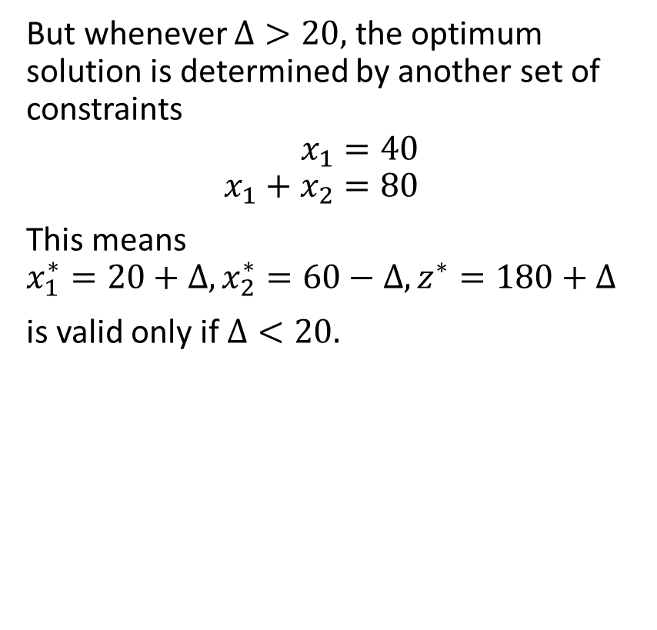
Changes in the RHS of the Constraints
But whenever $Δ>20,$ the optimum solution is determined by another set of constraints
$$x_{1}=40 \\ x_{1}+x_{2}=80$$
This means
$$x_{1}^{∗}=20+Δ, x_{2}^{∗}=60−Δ, z^{∗}=180+Δ$$
is valid only if $Δ<20.$
A
B
D
C

Slide 43
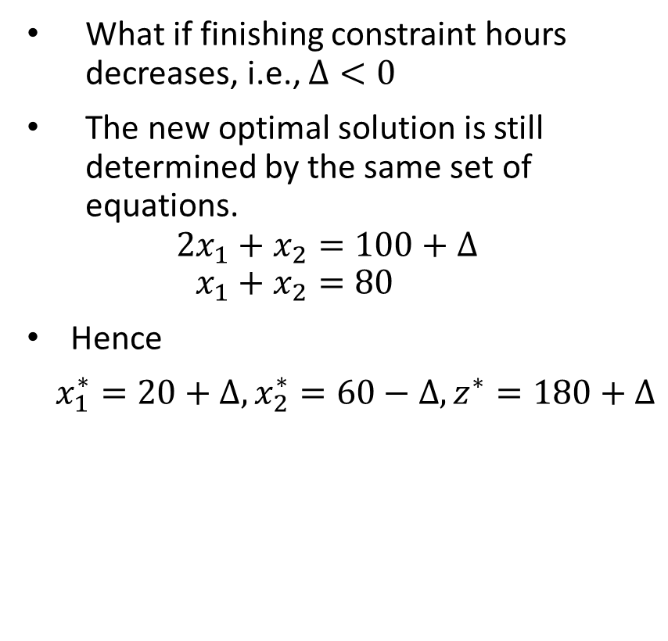
Changes in the RHS of the Constraints
What if finishing constraint hours decreases, i.e., $Δ<0$
The new optimal solution is still determined by the same set of equations.
$$2x_{1}+x_{2}=100+Δ \\ x_{1}+x_{2}=80$$
Hence
$x_{1}^{∗}=20+Δ, x_{2}^{∗}=60−Δ, z^{∗}=180+Δ$
A
B’
B
D
C

Slide 44
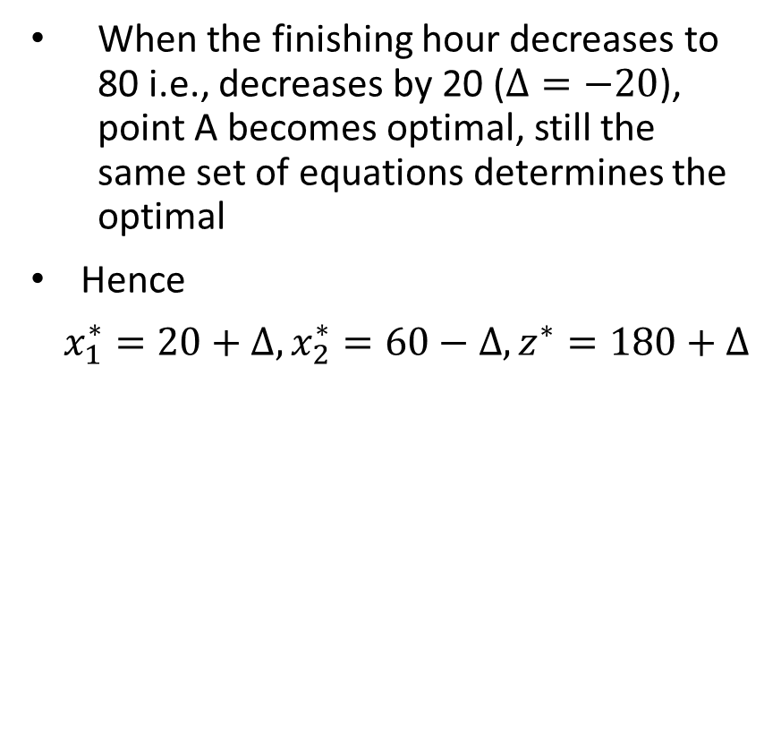
Changes in the RHS of the Constraints
When the finishing hour decreases to 80 i.e., decreases by 20 ($Δ=−20$), point A becomes optimal, still the same set of equations determines the optimal
Hence
$x_{1}^{∗}=20+Δ, x_{2}^{∗}=60−Δ, z^{∗}=180+Δ$
A
B
D
C

Slide 45
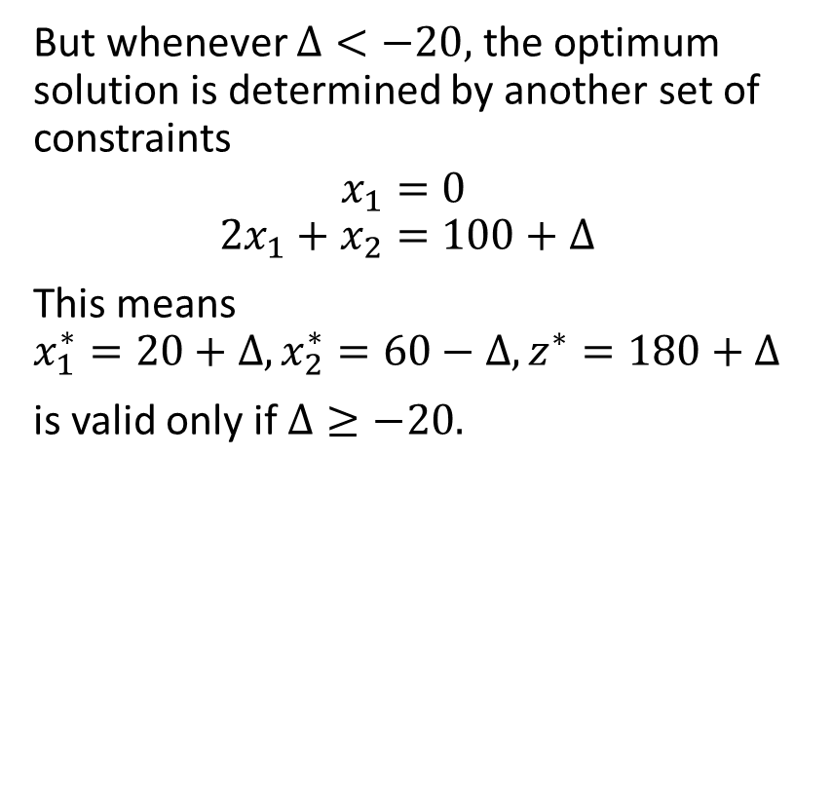
Changes in the RHS of the Constraints
But whenever $Δ<−20,$ the optimum solution is determined by another set of constraints
$$x_{1}=0 \\ 2x_{1}+x_{2}=100+Δ$$
This means
$$x_{1}^{∗}=20+Δ, x_{2}^{∗}=60−Δ, z^{∗}=180+Δ$$
is valid only if $Δ≥−20.$
A
B
D
C

Slide 46
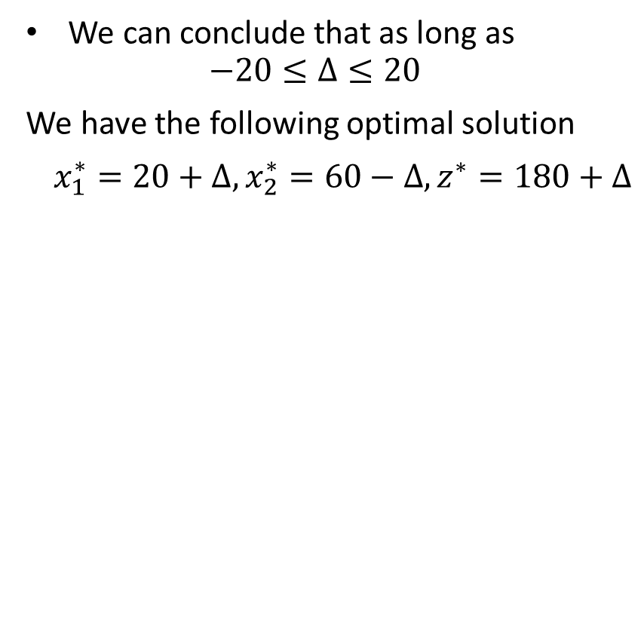
Changes in the RHS of the Constraints
We can conclude that as long as
$$−20≤Δ≤20$$
We have the following optimal solution
$x_{1}^{∗}=20+Δ, x_{2}^{∗}=60−Δ, z^{∗}=180+Δ$

Slide 47
Changes in the RHS of the Constraints
What happens if the right hand side of the carpentry hours constraint changes and becomes 90?

Slide 48
Changes in the RHS of the Constraints
What happens if the right hand side of the carpentry hours constraint changes and becomes 90?
The feasible region changes again and the optimal solution becomes (10,80) with an optimal value of 190.
The optimal value increased by 10 when we increase right hand side of the finishing constraint.

Slide 49
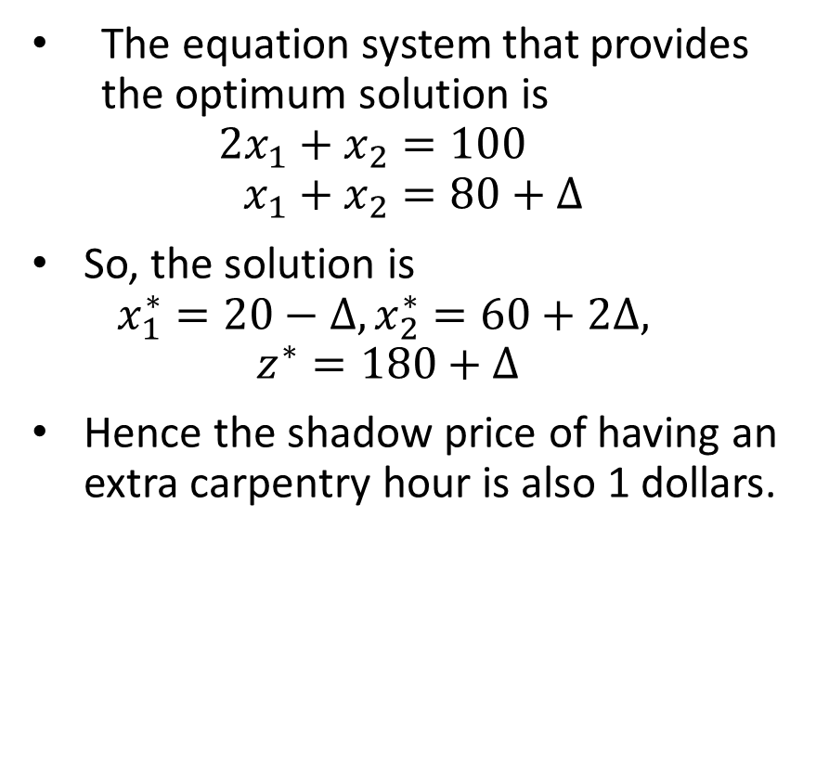
Changes in the RHS of the Constraints
The equation system that provides the optimum solution is
$$2x_{1}+x_{2}=100 \\ x_{1}+x_{2}=80+Δ$$
So, the solution is
$$x_{1}^{∗}=20−Δ, x_{2}^{∗}=60+2Δ,$$
$$z^{∗}=180+Δ$$
Hence the shadow price of having an extra carpentry hour is also 1 dollars.

Slide 50
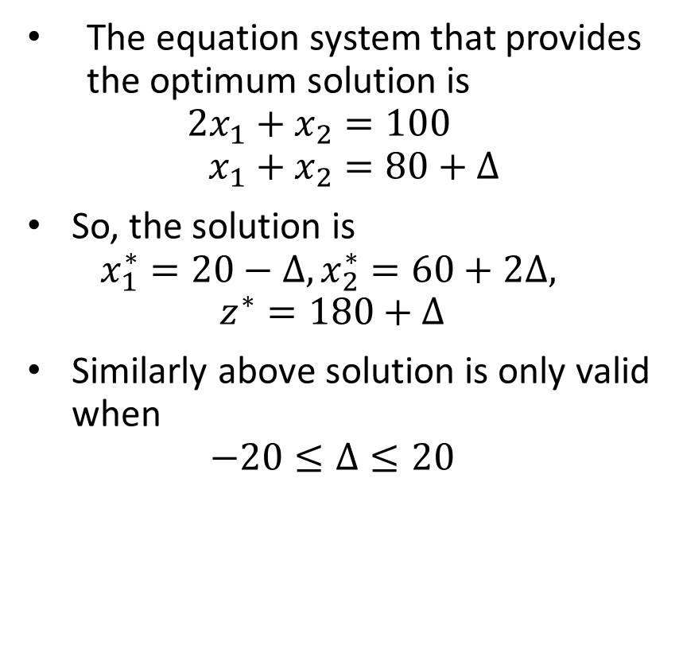
Changes in the RHS of the Constraints
The equation system that provides the optimum solution is
$$2x_{1}+x_{2}=100 \\ x_{1}+x_{2}=80+Δ$$
So, the solution is
$$x_{1}^{∗}=20−Δ, x_{2}^{∗}=60+2Δ,$$
$$z^{∗}=180+Δ$$
Similarly above solution is only valid when
$$−20≤Δ≤20$$

Slide 51
Changes in the RHS of the Constraints
Let us look at the demand for soldiers.
What if we have more demand on soldiers, say 45?
Do we produce more soldiers?

Slide 52
Changes in the RHS of the Constraints
Let us look at the demand for soldiers.
What if we have more demand on soldiers, say 45?
Do we produce more soldiers?
The feasible region changed but the optimum solution remains the same, because we cannot move the iso-profit line to the right.
Our optimal profit remains the same.
Having more demand does not contribute to our profit.
The shadow price of the demand is zero.

Slide 53
Sensitivity Analysis
We will not be doing this kind of analysis graphically for all problems.
It is even impossible to solve problems with more than 3 variables graphically
Excel solver provides a sensitivity report that gives us insights on these questions.
Let’s solve the Giapetto problem in excel solver and produce sensitivity report.

Slide 54
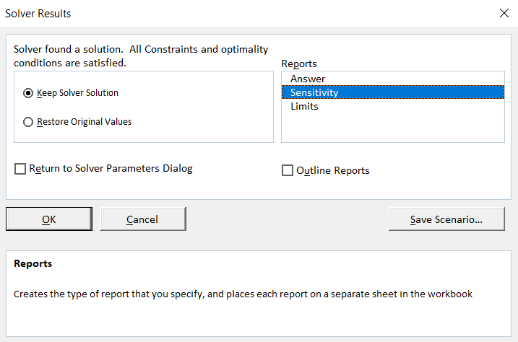
Solver Sensitivity Report
After solving the problem, you need to select sensitivity to create sensitivity report

Slide 55
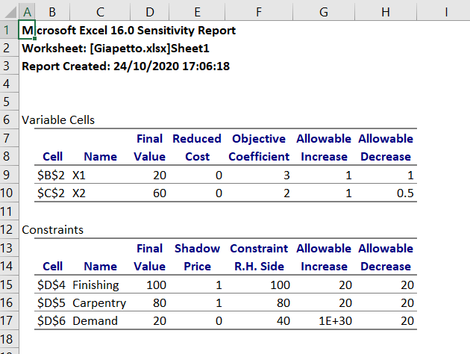
Solver Sensitivity Report
Ranges for which objective function coefficients can vary without changing the optimum solution
Optimal Values of Decision Variables
The values of left hand side of the constraints (gives us how much of the resource is used)
Shadow Prices (gives us how much our objective changes by a unit change in the right hand side of the constraint)

